Slide 1

Vehicle Purchase Recommendation Assignment
- Sai Praneeth Konduru

Slide 2
Project analysis slide 3
Project Steps
DATASET INTRODUCTION
EXCEL ANALYSIS
DATA TRANSFORMATION
CALCULATED COLUMNS
DASHBOARDS/ANALYSIS
Vehicle Test data:
Consists data regarding potential vehicles available for purchase.
Preliminary analysis of the dataset and its attributes.
Transformation of raw data tables using Power BI to output data in desired format.
Creation of calculated columns in Power BI to perform meaningful analysis.
Designing of interactive Dashboards with analysis to provide meaningful insights to make better decisions.

Slide 3
Project analysis slide 8
Dataset Introduction
Vehicle Test Data
This dataset consists of 1 .csv file with data regarding the potential vehicles available for purchase for Sue.
The data has 18 features & 10 observations. The data set has information such as Make, Model, Year, Safety Rating, Price, Kms, Length, Width, Tire Size, Engine Size, etc.

Slide 4
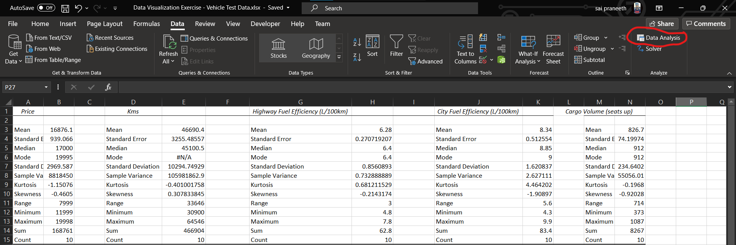
Project analysis slide 8
Excel Analysis
Using the Data Analysis option from the Data tab, analyzed the Descriptive Statistics for the important measures in the data.
There are a total of 10 records in the data which can be confirmed from the descriptive statistics count value.
From this analysis we can say that on average a car price is $16876.1.
On average Kms driven for a car would be 46690.4 Kms.
On average Highway Fuel Efficiency for a car would be 6.8L/100kms.
On average City Fuel Efficiency for a car would be 8.34L/100kms.
On average Cargo Volume for a car would be 826.7.

Slide 5
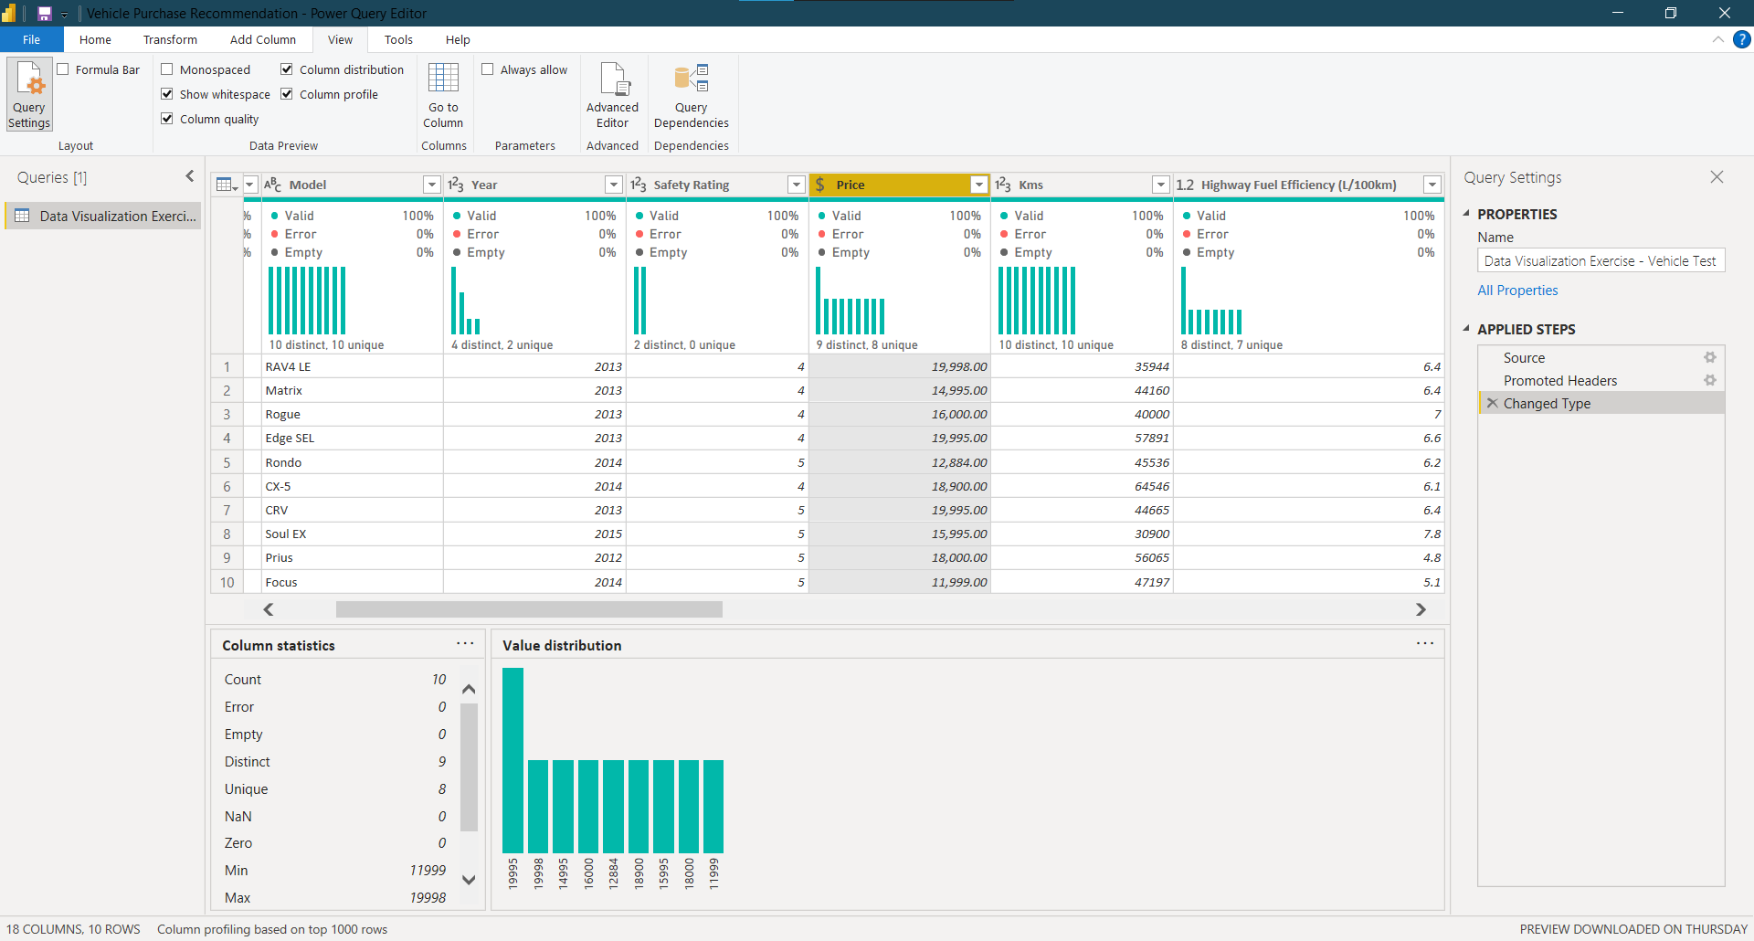
Project analysis slide 8
Data Transformation
in Power BI
Steps taken:
Step 1: For the Data, firstly the column quality, column distribution and column profile were analysed, then the next steps were taken.
Step 2: In the Data, the Headers were promoted and changed the datatype of ‘Price’ column to ‘Currency’ to present it in the right format and to be able to use it appropriately in the dashboard.
Note: Data Modelling and creating relationships was not required here since there is only one data table.

Slide 6
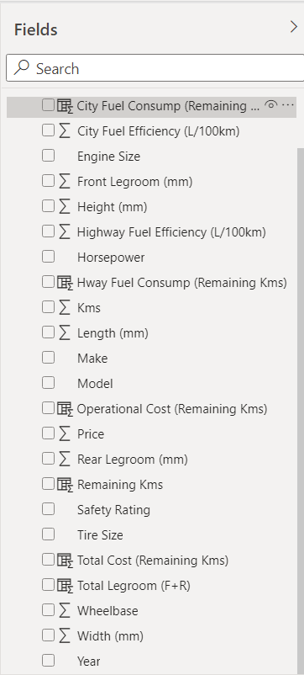
Project analysis slide 8
Assumptions made
1. Since Sue is expecting to drive the car extensively year around in the city as well as long distance driving, made an assumption that she drives equally in the city as well as on highways.
2. In order to calculate an approximate operational cost for each vehicle, made an assumption that gas price would be $1.25 per Litre (average).

Slide 7
Project analysis slide 8
Calculated Columns
in Power BI
Created 6 calculated columns making use of the assumptions made and the data fields available to perform analysis.
Remaining Kms: Since we know that Sue intends to drive the vehicle until the odometer reads 250,000 kms, using this data, calculated the remaining kms of each vehicle using the DAX formula
Remaining Kms = 250000 - 'Data Visualization Exercise - Vehicle Test Data'[Kms]
City Fuel Consumption for remaining kms: we have the information on each car’s city fuel efficiency, using this data, calculated the city fuel consumption of each car for the remaining kms from 250,000kms limit by using the DAX formula
City Fuel Consump (Remaining Kms) = (0.5 * 'Data Visualization Exercise - Vehicle Test Data'[Remaining Kms] * 'Data Visualization Exercise - Vehicle Test Data'[City Fuel Efficiency (L/100km)])/100
Highway Fuel Consumption for remaining kms: we have the information on each car’s highway fuel efficiency, using this data, calculated the highway fuel consumption of each car for the remaining kms from 250,000kms limit by using the DAX formula
Hway Fuel Consump (Remaining Kms) = (0.5 * 'Data Visualization Exercise - Vehicle Test Data'[Remaining Kms] * 'Data Visualization Exercise - Vehicle Test Data'[Highway Fuel Efficiency (L/100km)])/100

Slide 8
Project analysis slide 8
Calculated Columns
in Power BI
Operational Cost: we have the data from above calculations on fuel consumption of each car on highways and in city for the remainder kms from 250,000kms limit. Using this data, calculated the operational cost of each car with an assumption that gas price per litre is $1.25 on an average using the DAX formula
Operational Cost (Remaining Kms) = ('Data Visualization Exercise - Vehicle Test Data'[Hway Fuel Consump (Remaining Kms)] + 'Data Visualization Exercise - Vehicle Test Data'[City Fuel Consump (Remaining Kms)]) * 1.25
Total Cost: from the above calculations, we have the data regarding the prices as well as the operational costs for each car. Using this data, calculated the total cost for each car using the DAX formula
Total Cost (Remaining Kms) = 'Data Visualization Exercise - Vehicle Test Data'[Price] + 'Data Visualization Exercise - Vehicle Test Data'[Operational Cost (Remaining Kms)]
Total Legroom: we have the information on front and rear legroom space available in each car. Using this data, calculated the total legroom for each car using the DAX formula.
Total Legroom (F+R) = 'Data Visualization Exercise - Vehicle Test Data'[Front Legroom (mm)] + 'Data Visualization Exercise - Vehicle Test Data'[Rear Legroom (mm)]

Slide 9
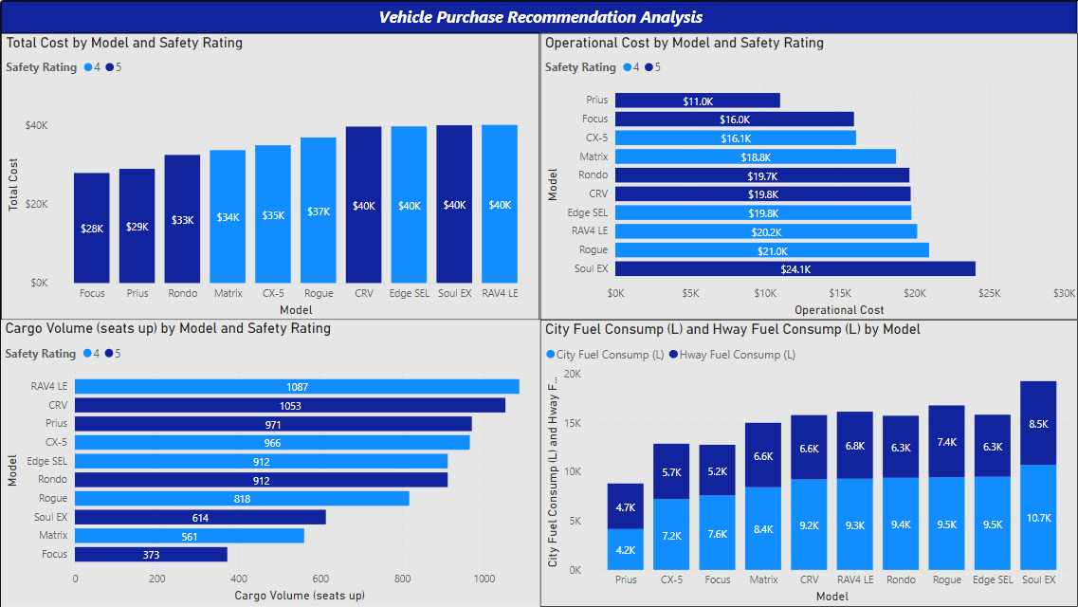
Project analysis slide 5
Analysis Dashboard 1

Slide 10
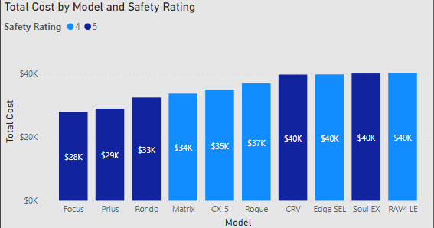
Project analysis slide 5
Analysis Dashboard 1
Visualizations
Chart 1: Total Cost by Model and Safety Rating:
Step 1: placed ‘Model’ in the Axis, ‘Total Cost (calculated column)’ in Values and ‘Safety Rating’ in Legend fields to display this visualization. Also placed some important fields in the Tooltips field to display important information.
Step 2: Renamed the fields in the visualization to display the names in the desired format.
This cart helps us analyse and compare the Total Cost (Price of the car along with the operational cost of the car for 250,000kms) of each car by their respective Safety Rating with other available cars.
As per the analysis and the problem parameters, we can say that the top 3 cars are ‘Focus’ with a total cost of $28K and safety rating of 5, ‘Prius’ with a total cost of $29K and safety rating of 5 and then ‘Rondo’ with a total cost of $33K and safety rating of 5.

Slide 11
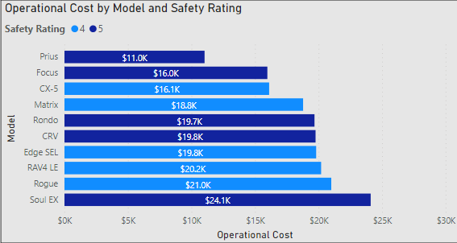
Project analysis slide 5
Analysis Dashboard 1
Visualizations
Chart 2: Operational Cost by Model and Safety Rating:
Step 1: placed ‘Model’ in the Axis, ‘Operational Cost (calculated column)’ in Values and ‘Safety Rating’ in Legend fields to display this visualization. Also placed some important fields in the Tooltips field to display important information.
Step 2: Renamed the fields in the visualization to display the names in the desired format.
This cart helps us analyse and compare the Operational Cost (for 250,000kms) of each car by their respective Safety Rating with other available cars.
As per the analysis, we can say that the top 3 cars are ‘Prius’ with operational cost of $11K and safety rating of 5, ‘Focus’ with operational cost of $16K and safety rating of 5 and then ‘CX-5’ with operational cost of $16.1K and safety rating of 4.

Slide 12
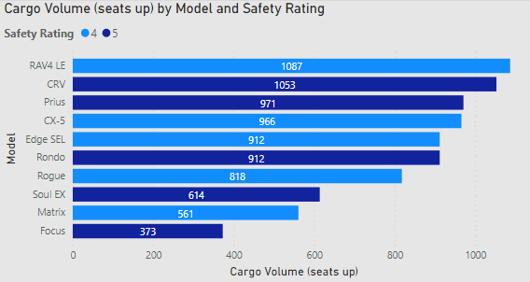
Project analysis slide 5
Analysis Dashboard 1
Visualizations
Chart 3: Cargo Volume by Model and Safety Rating:
Step 1: placed ‘Model’ in the Axis, ‘Cargo Volume’ in Values and ‘Safety Rating’ in Legend fields to display this visualization. Also placed some important fields in the Tooltips field to display important information.
Step 2: Renamed the fields in the visualization to display the names in the desired format.
This cart helps us analyse and compare the Cargo Volume of each car by their respective Safety Rating with other available cars.
As per the analysis, we can say that the top 3 cars are ‘RAV4 LE’ with cargo volume of 1087 and safety rating of 4, ‘CRV’ with cargo volume of 1053 and safety rating of 5 and then ‘Prius’ with cargo volume of 971 and safety rating of 5.

Slide 13
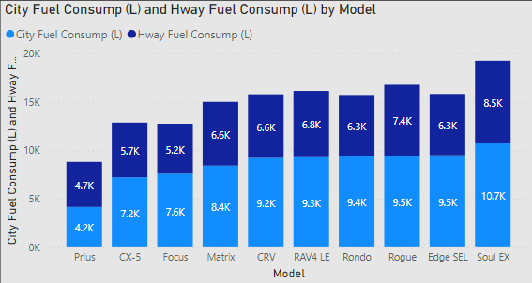
Project analysis slide 5
Analysis Dashboard 1
Visualizations
Chart 4: City Fuel Consumption and Highway Fuel Consumption by Model:
Step 1: placed ‘Model’ in the Axis, ‘City Fuel Consump’ and ‘Highway Fuel Consump’ in Values fields to display this visualization. Also placed some important fields in the Tooltips field to display important information.
Step 2: Renamed the fields in the visualization to display the names in the desired format.
This cart helps us analyse and compare the City and Highway fuel consumption (for 250,000kms) of each car with other available cars.
As per the analysis, we can say that the top 3 cars are ‘Prius’ with city & highway fuel consumptions of 4.2K L & 4.7K L, ‘CX-5’ with city & highway fuel consumptions of 7.2K L & 5.7K L and then ‘Focus’ with city & highway fuel consumptions of 7.6K L & 5.2K L.

Slide 14
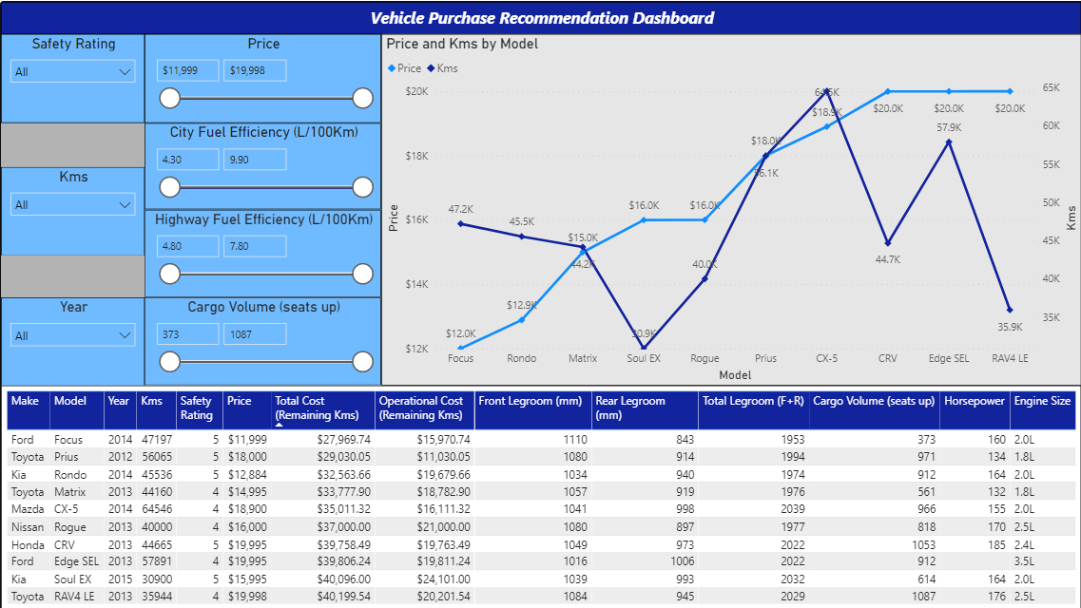
Project analysis slide 5
Analysis Dashboard 2
Slicers/Filters (top left): Allow the user to select and filter through the visualizations for analysis.
Line Chart (top right): visualizes the Price and Kms of the cars distributed by Model.
Table Chart (bottom): illustrates the key characteristics of the cars. This table chart has been sorted to display the recommendations for the cars as per selections from top to bottom.

Slide 15
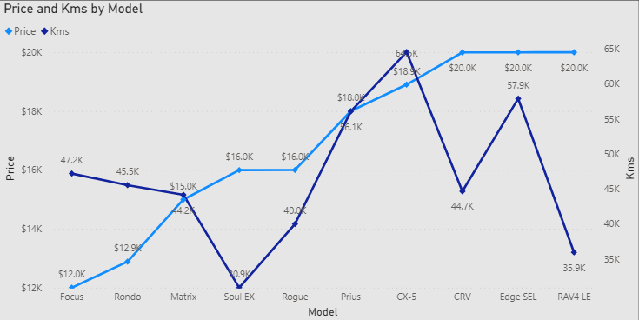
Project analysis slide 5
Analysis Dashboard 2
Visualizations
Chart 1: Price and Kms by Model:
Step 1: placed ‘Model’ in the Axis, ‘Price’ in Values and ‘Kms’ in Secondary Values fields to display this visualization. Also placed some important fields in the Tooltips field to display important information.
Step 2: Renamed the fields in the visualization to display the names in the desired format.
This cart helps us analyse and compare the purchase price and kms driven of each car with other available cars.
As per the analysis, we can say that the top 3 price economical cars are Focus for $12K, Rondo for $12.9K and Matrix for $15K. Whereas the top 3 least kms driven cars are Soul Ex with 30.9K kms, RAV4 LE with 35.9K kms and Rogue with 40K kms.

Slide 16
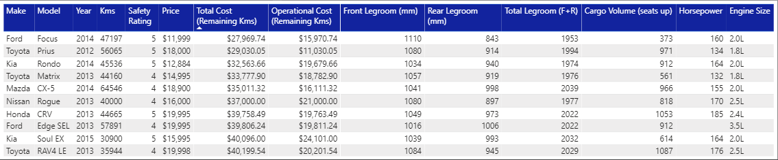
Project analysis slide 5
Analysis Dashboard 2
Visualizations
Chart 2: Top Recommendations with car characteristics:
Step 1: placed all the required data fields in Values field to display this visualization.
Step 2: Renamed the fields in the visualization to display the names in the desired format.
This cart helps us analyse and compare the key characteristics of each car with other available cars.
This chart provides the top recommendations of the cars based on the Filters/slicers selected by the user. If no filter/slicer is selected, this chart displays all the available cars details with best recommendations from top to bottom.
As per the analysis, we can say that the top cars as per the problem parameters are Ford Focus, Toyota Prius and Kia Rondo. Whereas the bottom 3 cars are Toyota RAV4 LE, Kia Soul EX and Ford Edge SEL considering all the problem parameters.

Slide 17
Project analysis slide 5
Recommendations
Based on our analysis, even though the best car is 2014 Ford Focus, this is not the best car for Sue as per the problem parameters given. This car satisfies the utmost important requirement which is the Safety Rating which is 5, total cost of the car by owning and operating it until 250,000kms is $27,970 which is the most economical among others, operational cost is $15,970 which is the second best among others, best in front legroom but does not satisfy the cargo volume requirement as it is just 373 which is the least among all the cars.
Based on the problem parameters given and our analysis, the best car to recommend to Sue is 2012 Toyota Prius. Though this is placed 2nd in the table chart analysis, this car satisfies all the problem parameters. Safety rating is 5, total cost is second best with $29,030, best operational cost with $11,030, good enough cargo volume and front & rear legroom.
The second recommendation to Sue would be 2014 Kia Rondo. Though this is placed 3rd in the table chart analysis, this car satisfies all the problem parameters as well. Safety rating is 5, total cost is third best with $32,563, good cargo volume and good front & rear legroom as well. Moreover, this car is a 2014 model which would have better features compared to 2012 Toyota Prius.
The third recommendation to Sue would be 2014 Mazda CX-5. Though this is placed 5th in the table chart analysis, this car is also a good option since this car also satisfies most of the problem parameters except for safety rating which is 4. If safety rating of 4 (which is not a bad option) is considered, then this car also has good characteristics including total cost, operational cost, legroom and cargo volume.

Slide 18
Thank You

